Slide 1
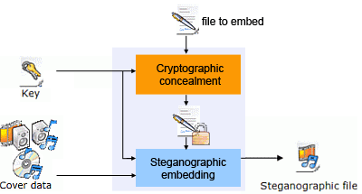
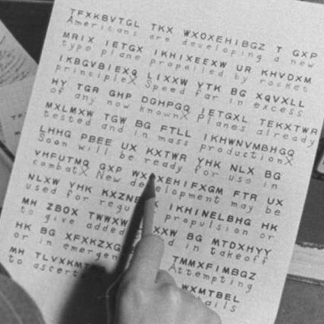
Crypto- stegano- & even smth about hashcodes

Slide 2
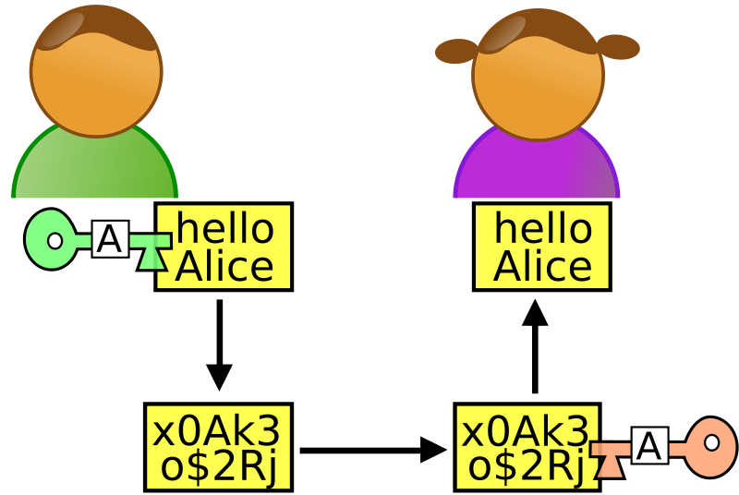
Cryptography
Ancient Ciphers
Enigma
Demonstrations
Symmetric-key algorithm
Asymmetric cryptography

Slide 3
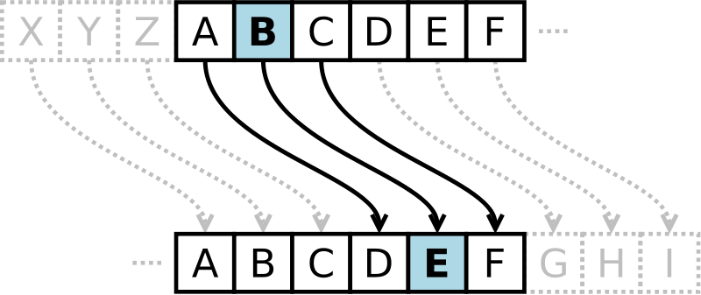

Caesar cipher
Plain: ABCDEFGHIJKLMNOPQRSTUVWXYZ
Cipher: XYZABCDEFGHIJKLMNOPQRSTUVW
En(x) = (x + n) mod 26
Dn(x) = (x – n) mod 26
$$A=πr^{2}$$
Ciphertext: QEB NRFZH YOLTK CLU GRJMP LSBO QEB IXWV ALD
Plaintext: the quick brown fox jumps over the lazy dog

Slide 4
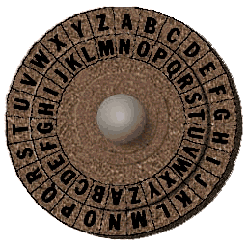
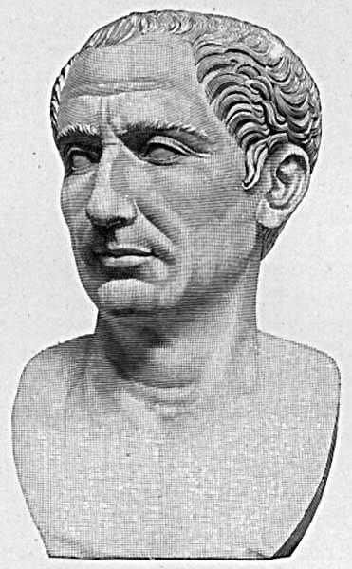
The disk with a Caesar cipher

Slide 5
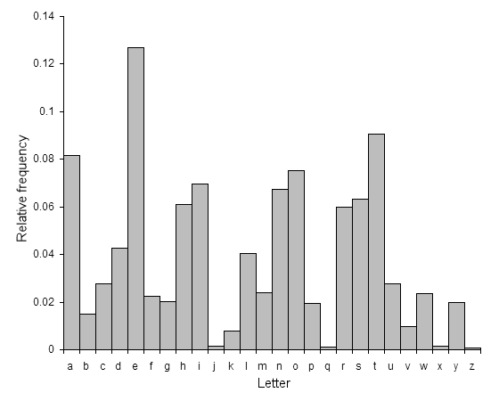
Breaking
Decryption shift | Candidate plaintext
0 | exxegoexsrgi
1 | dwwdfndwrqfh
2 | cvvcemcvqpeg
3 | buubdlbupodf
4 | attackatonce
5 | zsszbjzsnmbd
6 | yrryaiyrmlac
...
23 | haahjrhavujl
24 | gzzgiqgzutik
25 | fyyfhpfytshj

Slide 6
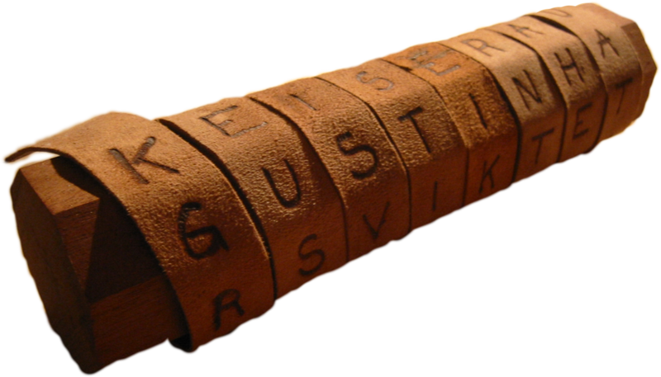
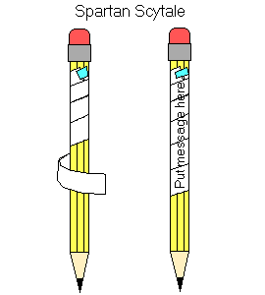
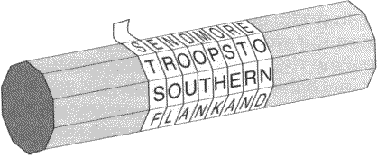
Scytale
Help me I am under attack -> HENTEIDTLAEAPMRCMUAK

Slide 7
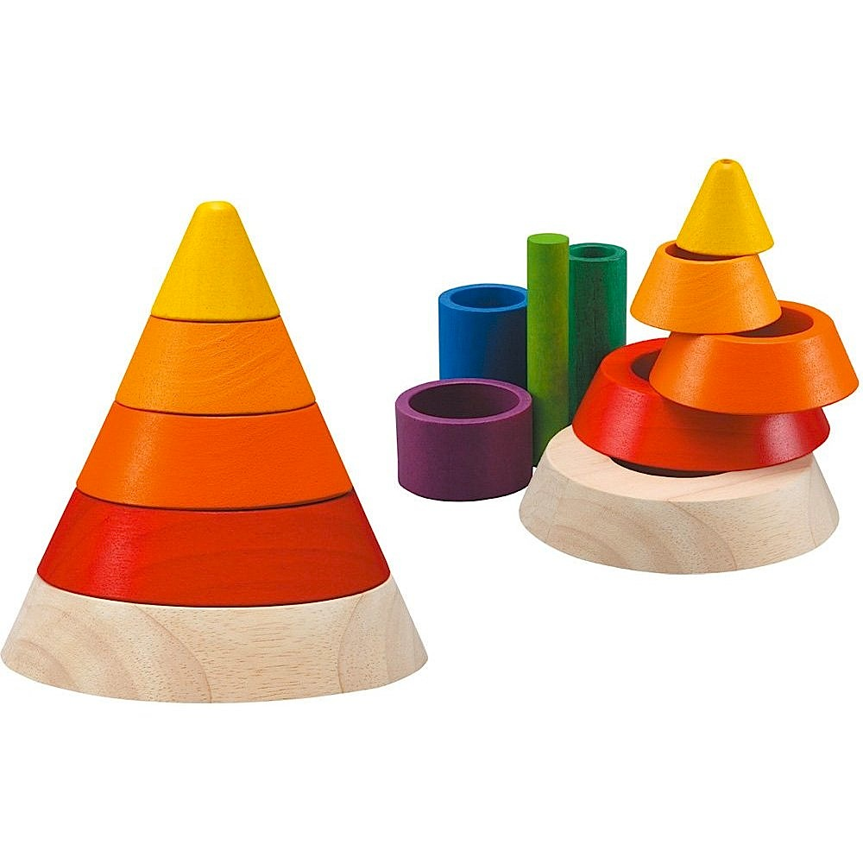
Breaking

Slide 8
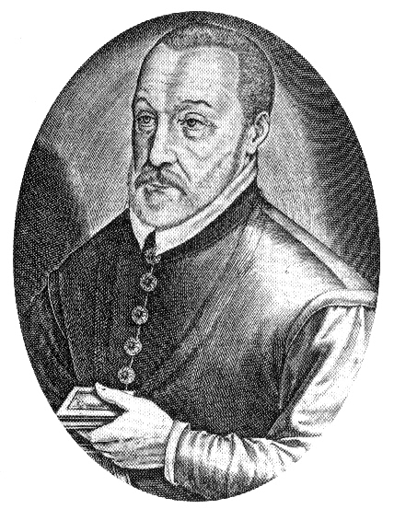
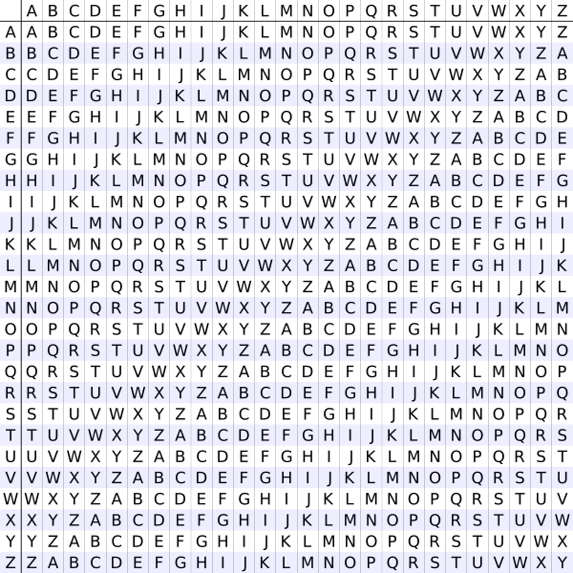
Vigenère cipher
C(x) = (P(x) + K(x)) mod 26
P(x) = (C(x) – K(x)) mod 26
Plain Text: A T T A C K A T D A W N
Key: L E M O N L E M O N L E
Cipher Text: L X F O P V E F R N H R

Slide 9
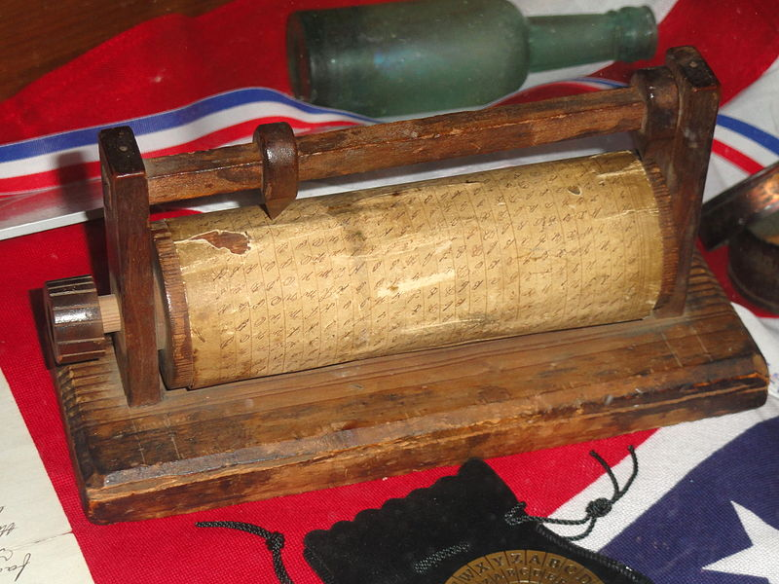
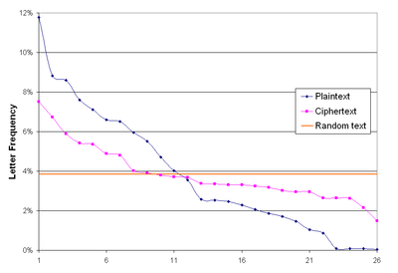
Breaking

Slide 10
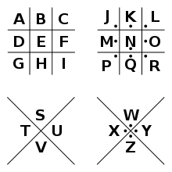
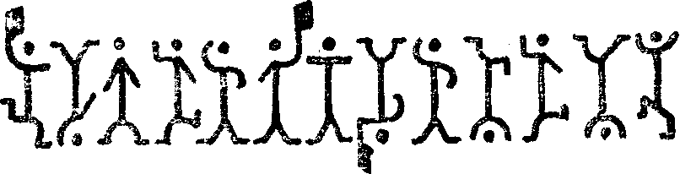
Cryptograms

Slide 11
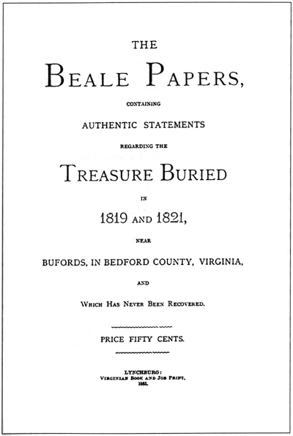
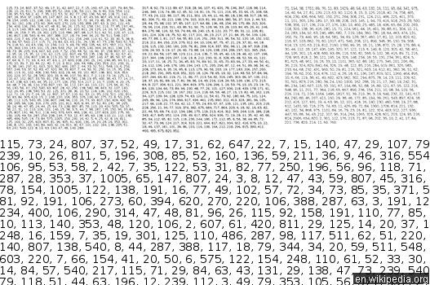
Beale ciphers

Slide 12
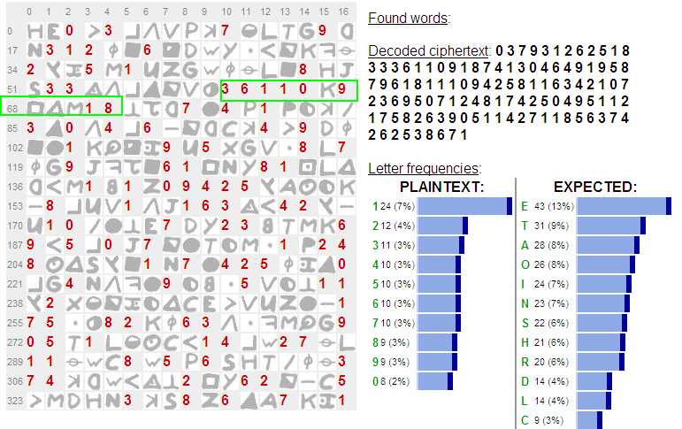
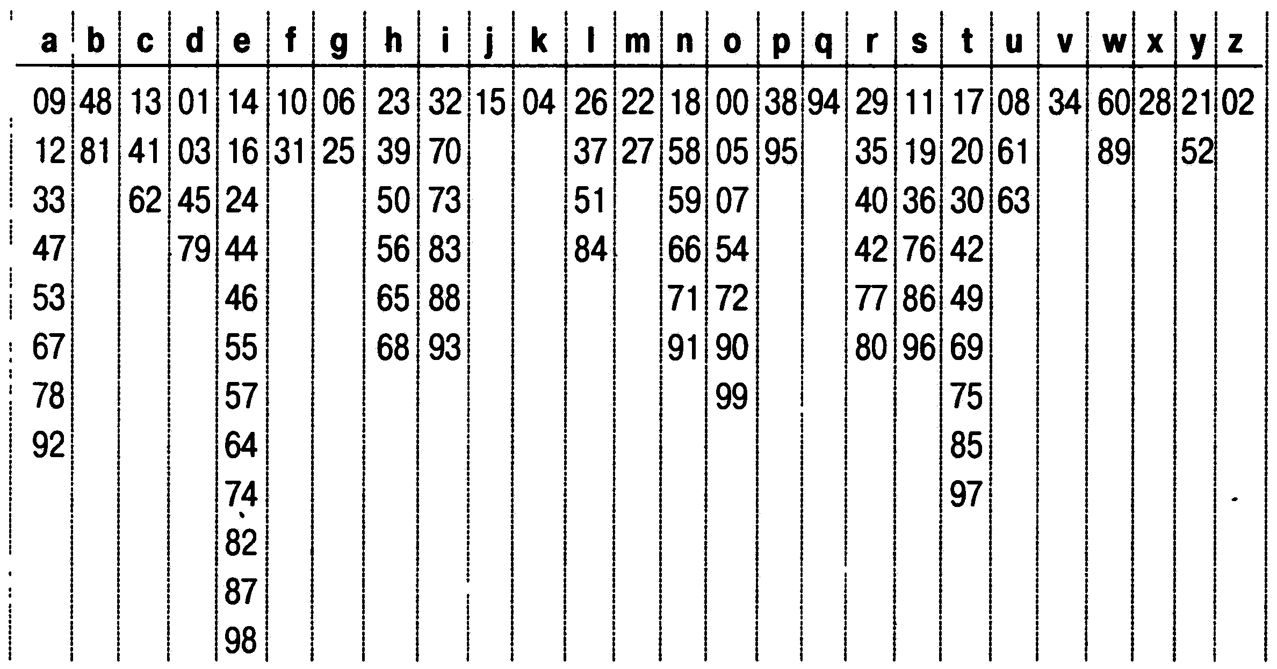
Homophones Cipher

Slide 13
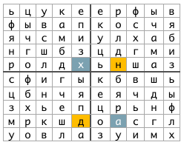
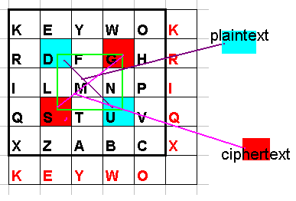
Playfair Cipher

Slide 14
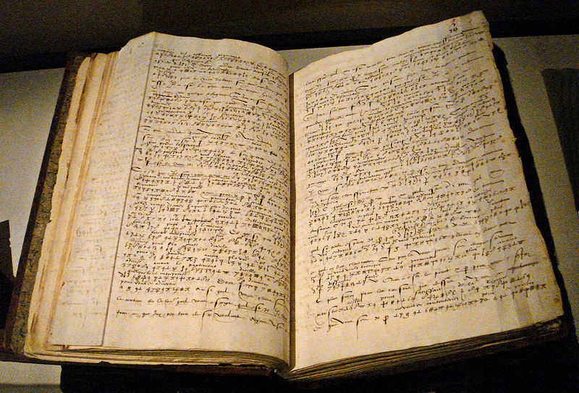
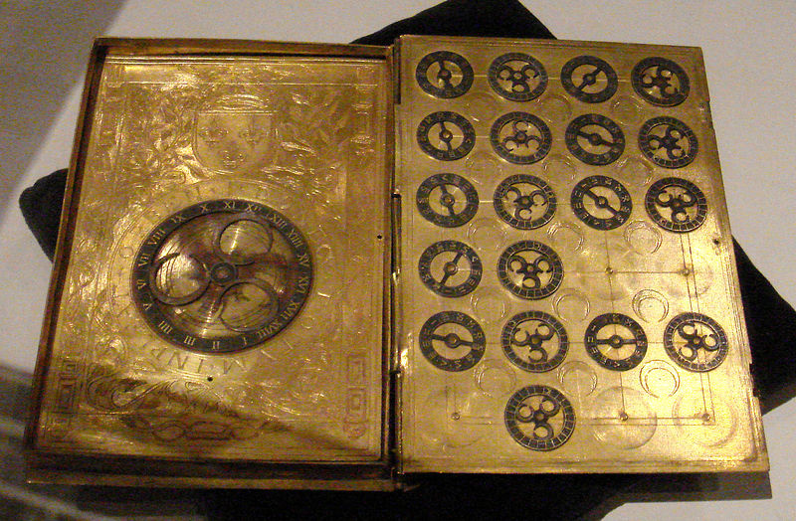
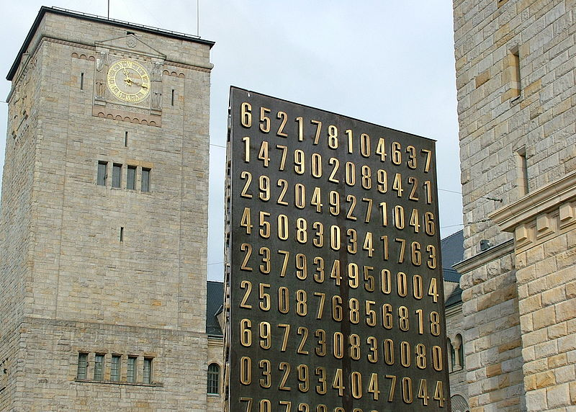
a few centuries pass

Slide 15
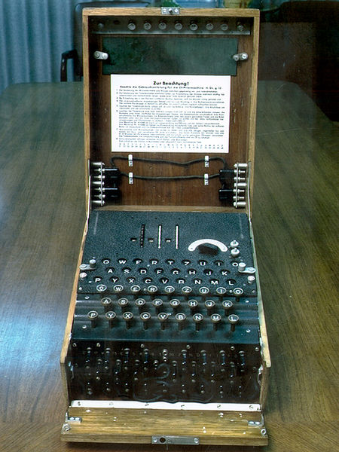
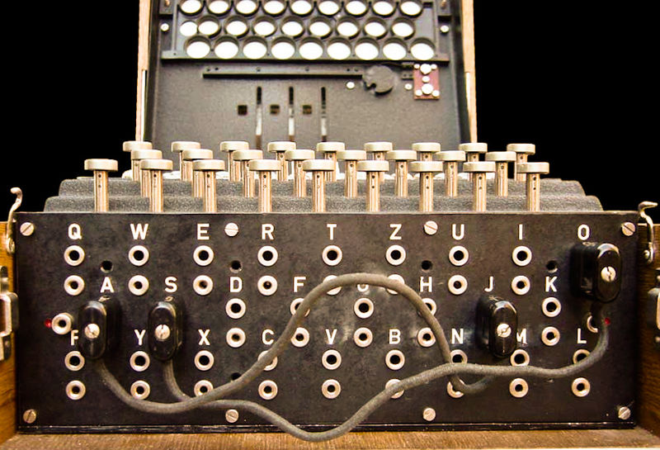
Enigma

Slide 16
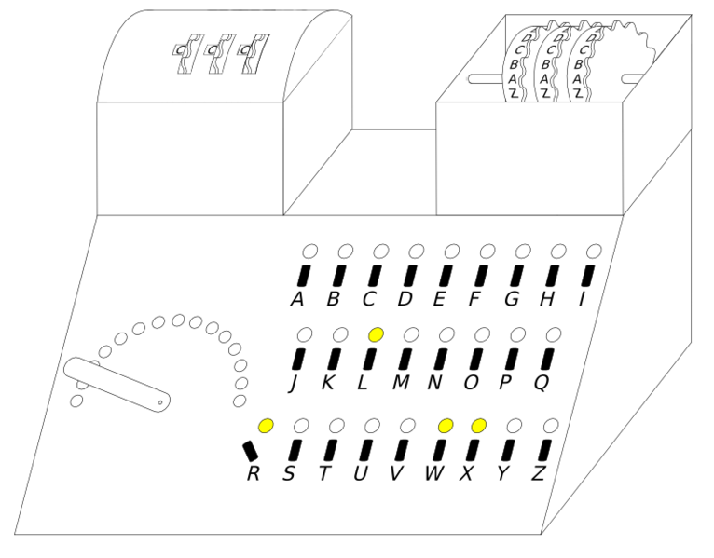
Demonstration?

Slide 17
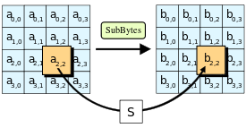
Modern Symmetric-key algorithm
Disadvantages
Loads of keys
Translating keys
Advantages
Quick
Easy
Short Key
C(x) = F(x)
P(x) = F(C(x))

Slide 18
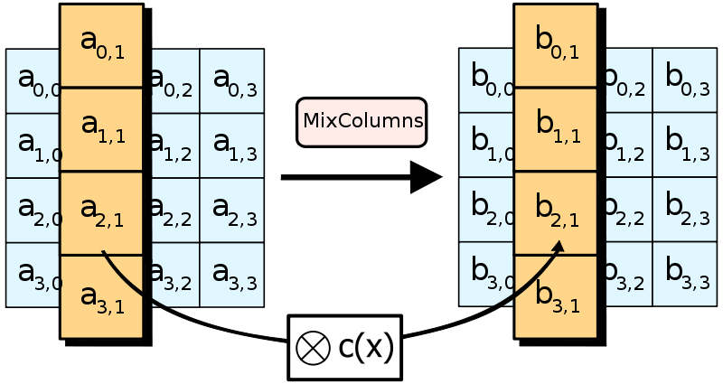
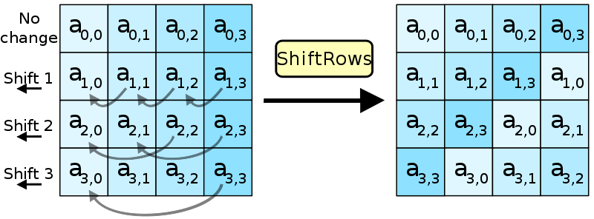
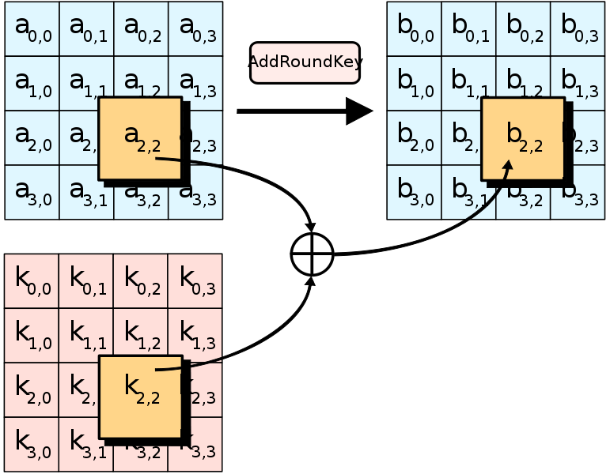
Advanced Encryption Standard (AES)

Slide 19
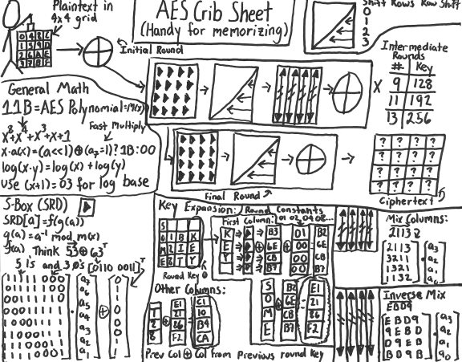
Breaking
8 Rows

Slide 20


Slide 21
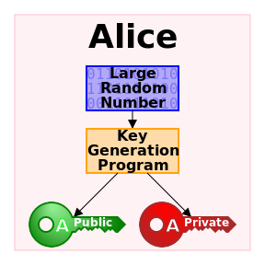
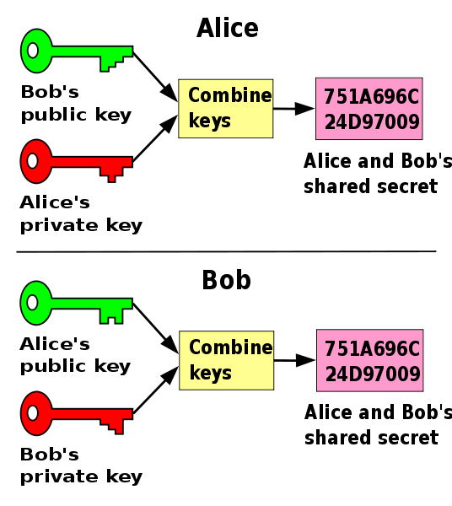
Modern Asymmetric cryptography

Slide 22
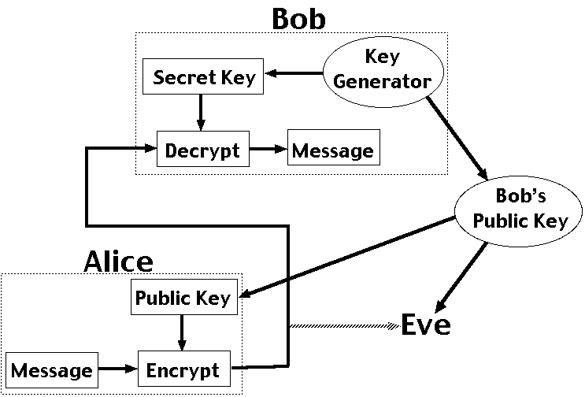
RSA (Rivest, Shamir и Adleman)

Slide 23

Sample
M = 88
C = 88^7 mod 187 = (88 * 88^2 * 88^4) mod 187 = (88 * 77 * 132) mod 187 = 894432 mod 187 = 11
M = 11^23 mod 187 = 88
Profit!
p =17
q = 11
N = p*q = 187
e = 7
Open Key(e, N)
C = M^e mod N
e * d = 1 mod (p-1)*(q-1)
d = 23
M = C^d mod N
Close Key (d, N)

Slide 24
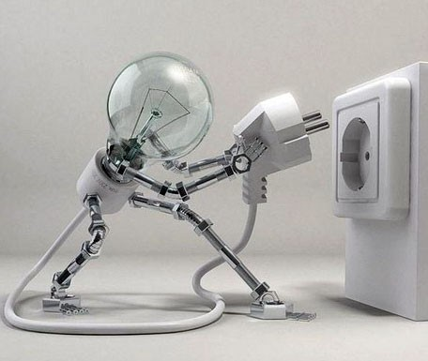
Breaking?

Slide 25


Slide 26

Stegano

Slide 27
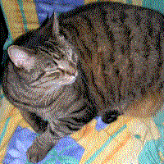

SAmple

Slide 28
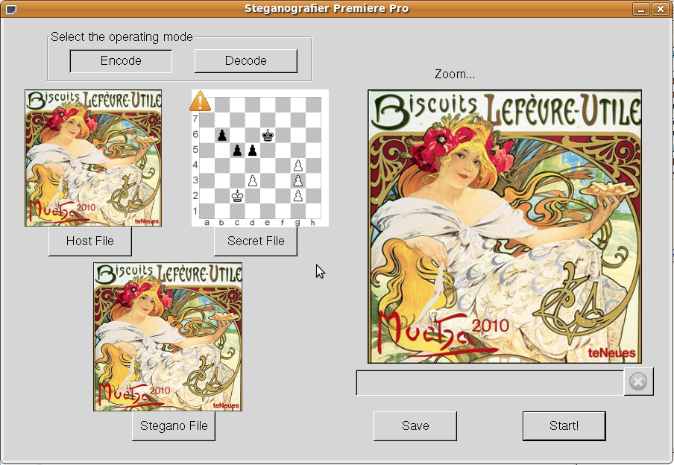
Sample

Slide 29
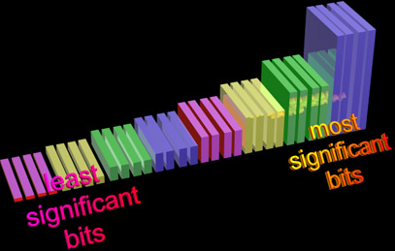
Idea

Slide 30

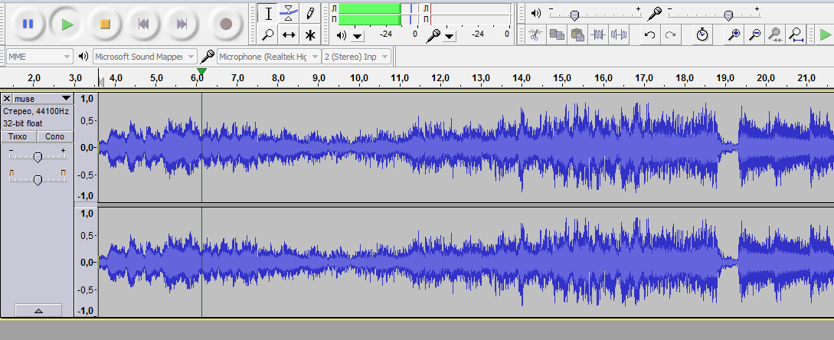
Possible media
Audio
Video
Photo

Slide 31

HashCodes
Control of Loss
Signature
Passwords

Slide 32
Password
$password = 'password'; //Сам пароль
$hash1 = md5($password); //Хешируем первоначальный пароль
$salt = 'sflprt49fhi2'; //Генерируем случайный набор символов (соль)
$hash2 = md5($hash1 . $salt); //Складываем старый хеш с солью и пропускаем через функцию md5()

Slide 33
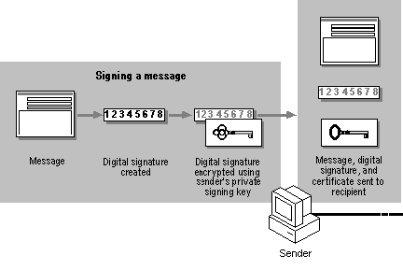
Signature

Slide 34
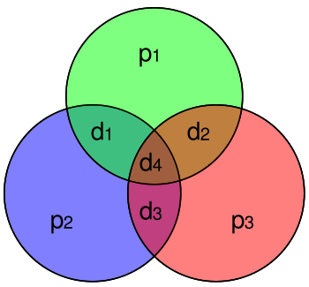
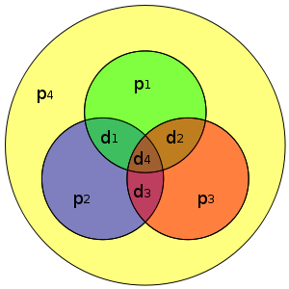
Hamming code

Slide 35
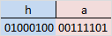
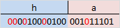
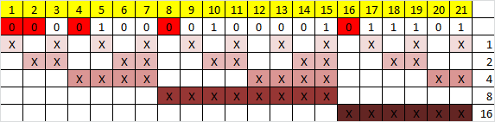
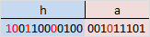

Slide 36
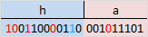

1 + 2 + 8 = 11

Slide 37





Thnx

Slide 38

That’s AlL =)

